Slide 1


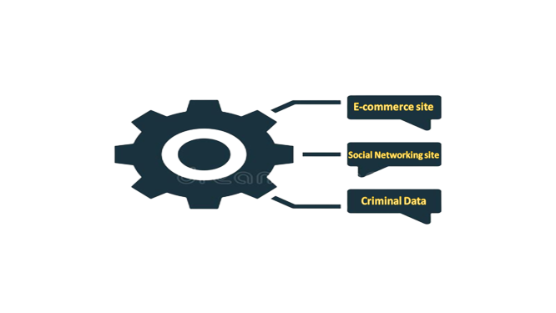
SAGAR INSTITUTE OF SCIENCE AND TECHNOLOGY
Design and Development of Student Attendance Through Face Recognition
Presented by
Guided by
Hardik Kushwaha
Prof. Komal Tahiliani
Him Shrivas
Harshit Dongre
Mohit Malviya

Slide 2
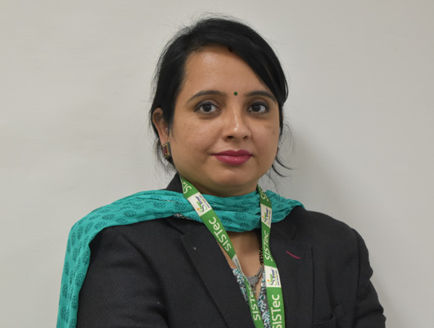
Project Guide
Name: Prof. Komal Tahiliani
Designation: Assistant Professor

Slide 3
Let’s try to change the current attendance system..
1
Let’s start with the understanding the Deep Learning.

Slide 4
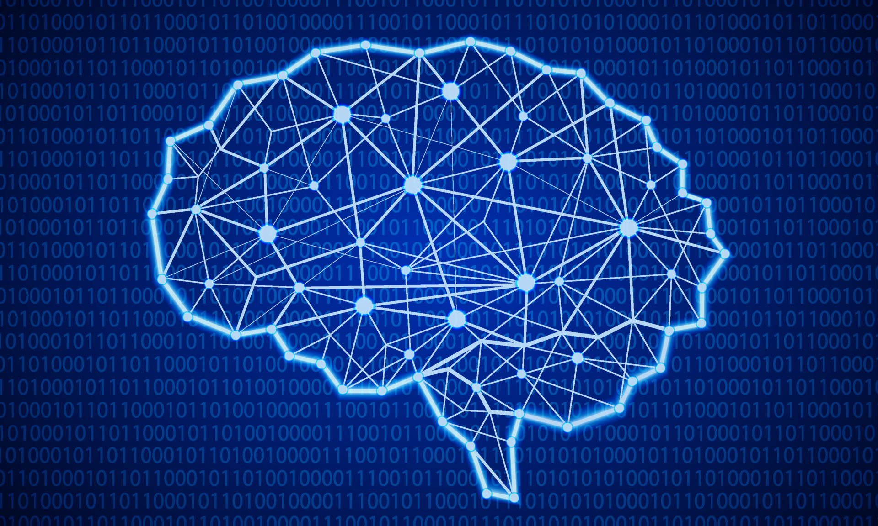
INTRODUCTION
Deep learning is a subset of machine learning, which is essentially a neural network with three or more layers. These neural networks attempt to simulate the behavior of the human, allowing it to “learn” from large amounts of data. While a neural network with a single layer can still make approximate predictions, additional hidden layers can help to optimize and refine for accuracy.

Slide 5
Models
VGG16
VGG-16 is a convolutional neural network that is 16 layers deep. You can load a pretrained version of the network trained on more than a million images from the ImageNet database. The pretrained network can classify images into 1000 object categories, such as keyboard, mouse, pencil, and many animals. As a result, the network has learned rich feature representations for a wide range of images. The network has an image input size of 224-by-224.

Slide 6
Models
InceptionV3
The inception v3 model was released in the year 2015, it has a total of 42 layers and a lower error rate than its predecessors. Let's look at what are the different optimizations that make the inception V3 model better.
The major modifications done on the Inception V3 model are
Factorization into Smaller Convolutions
Spatial Factorization into Asymmetric Convolutions
Utility of Auxiliary Classifiers
Efficient Grid Size Reduction

Slide 7
👉
Functional Requirement
Actor Admin
Login
Register Faculty
Update Faculty Details
Actor Faculty
Login
Update Attendance
Manage Students
View Overall Attendance

Slide 8
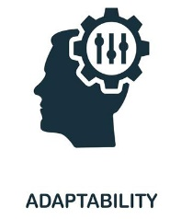

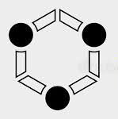

NON- FUNCTIONAL REQUIREMENTS
Adaptability
Flexibility
Correctness
Maintainability
There can be changes in the details stored in the database about Student, Faculty and their content.
If need arises in the future, software can be modified to change the requirements.
The details stored in the database or in the view sections of our software should be same as entered by the actors.
Software can be easily repaired and modified if a fault occurs.

Slide 9

Tools and Technology
Html
CSS
JavaScript
Django
Python
FireBase
GoogleCollab

Slide 10
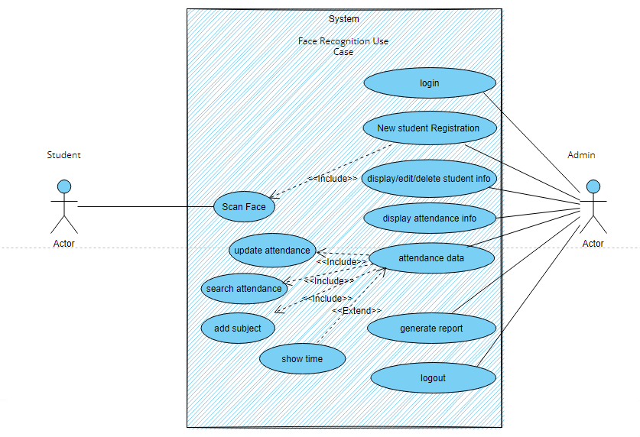
Use Case Diagram

Slide 11
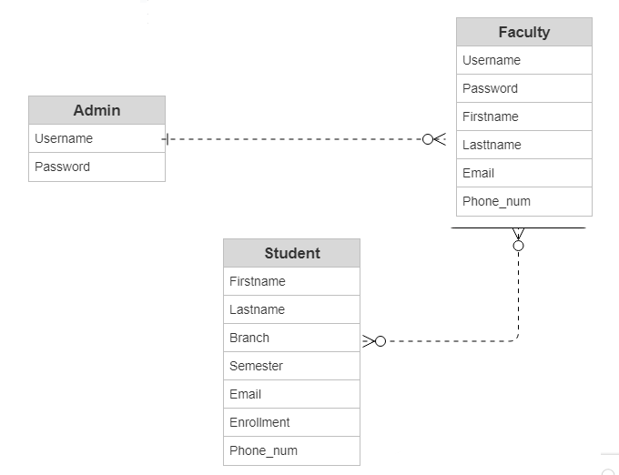
E R Diagram

Slide 12
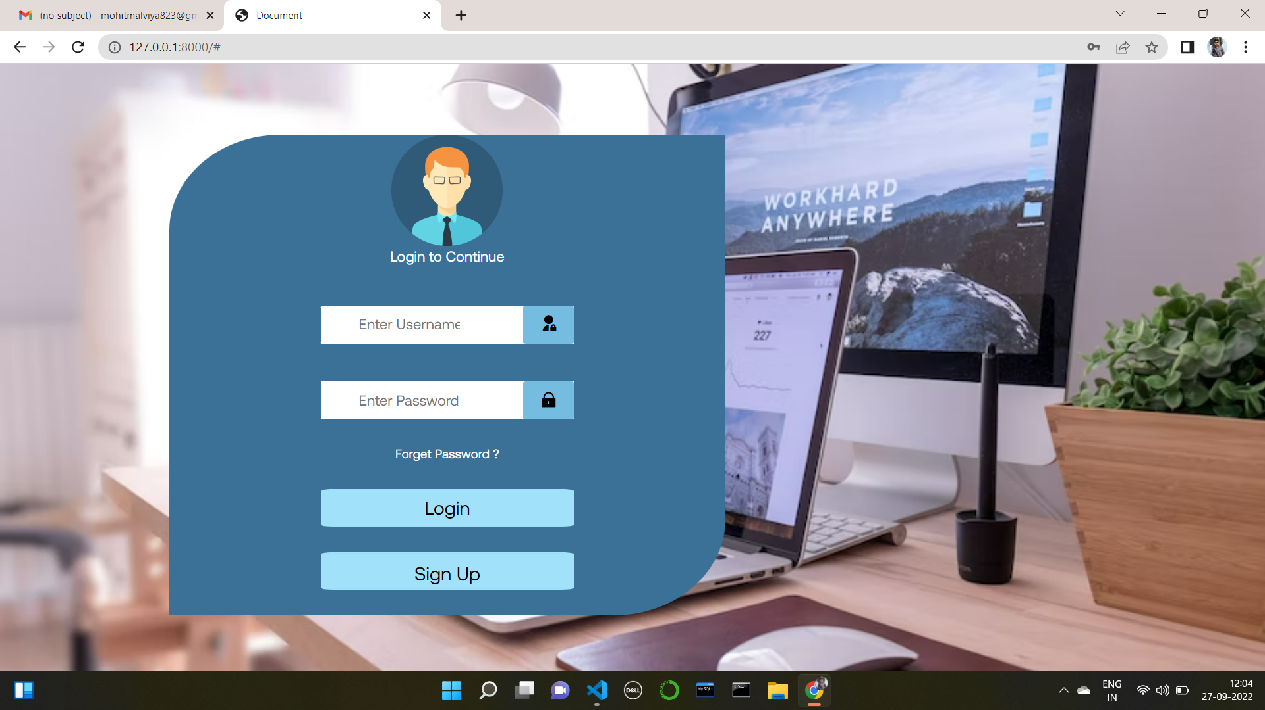
SNAPSHOTS

Slide 13
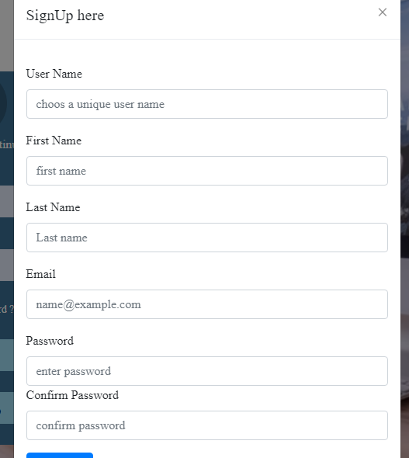
Signup page

Slide 14
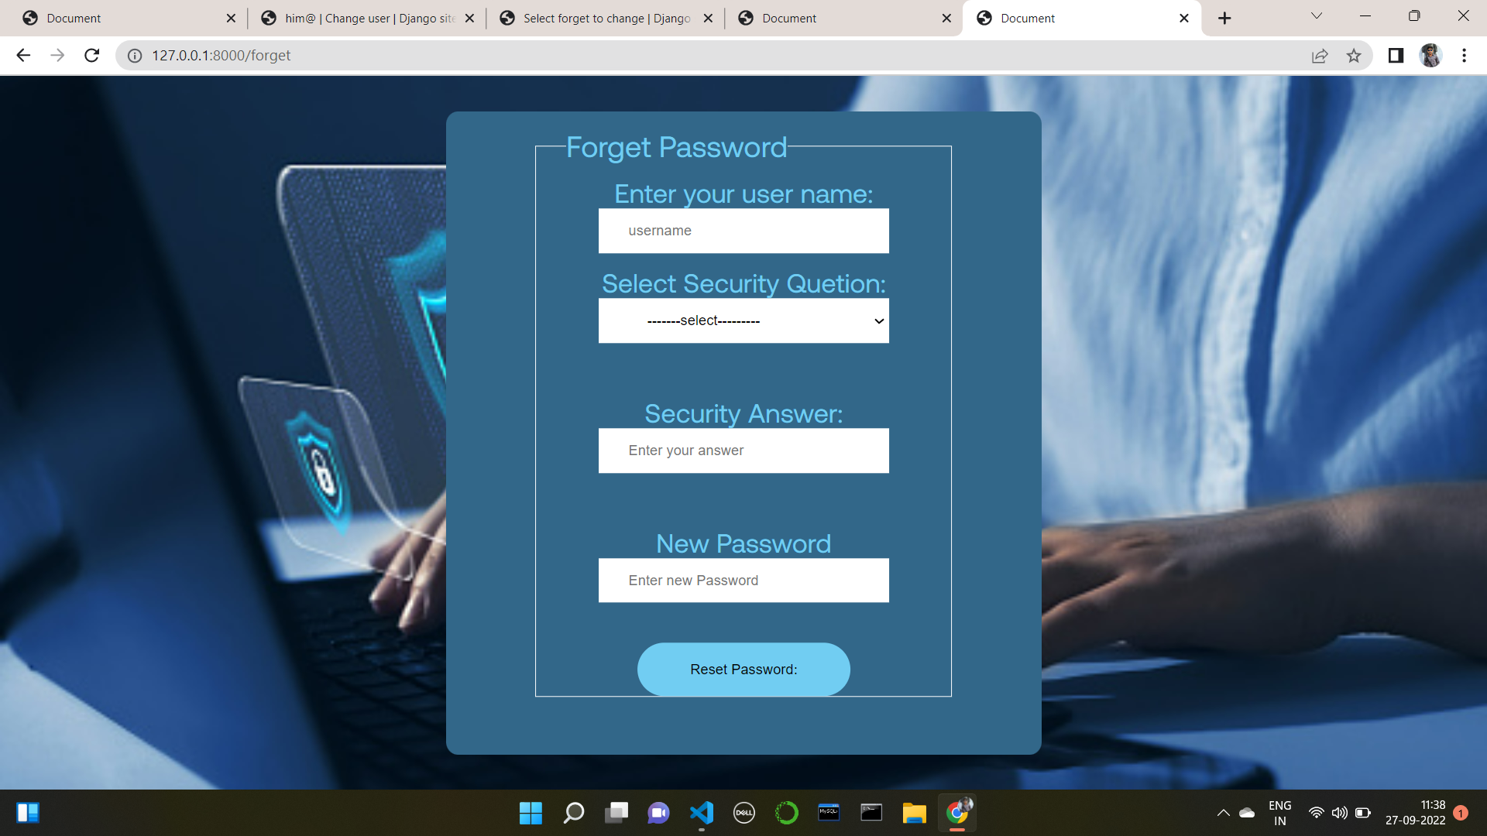

Slide 15
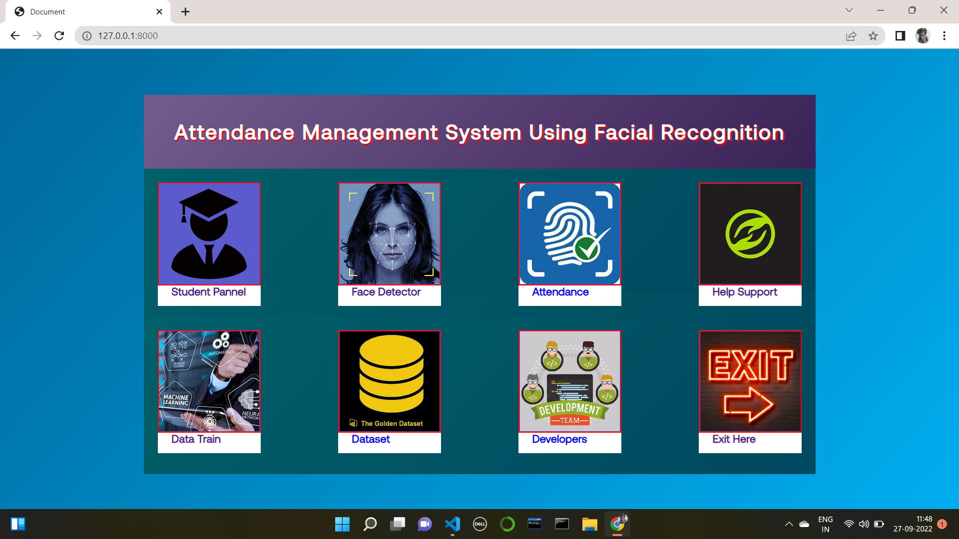

Slide 16
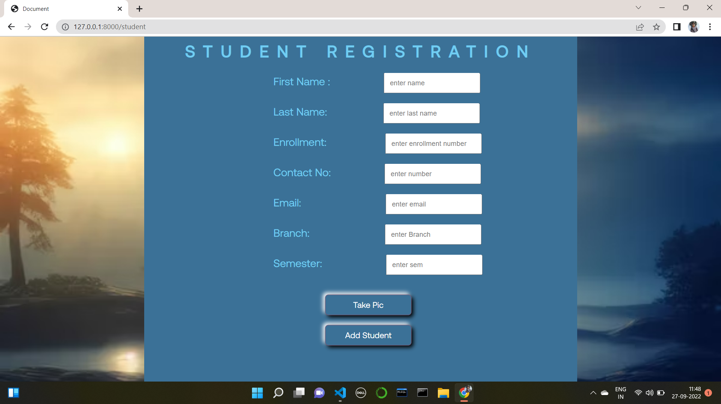

Slide 17
References
YOUTUBE
https://www.youtube.com/
Google
https://www.google.com/
Github
https://github.com/
Stack Overflow
https://stackoverflow.com/
GeeksforGeeks
https://www.geeksforgeeks.org/
Wikipedia
https://www.wikipedia.org/

Slide 18
THANKS!

